Slide 1
Optimizing Product Descriptions
Coors Light vs. Bud Light
Notes:
Good afternoon! Thanks for taking the time to sit in on our optimality analysis.
My name is Chuck, and I am going to start us off on this small adventure.

Slide 2


Online B2C Sales
Beer and Malt beverage eCommerce sales
Product description improvement
Notes:
As you all know, beer and malt beverage sales are of growing importance, and one of the key-ways to improve sales is optimizing product descriptions on all platforms

Slide 3
Establishing Data Foundation
NLP
Extraction
Brand Focus
Cross-Product
Benchmarking
Optimization Output
Notes:
What we wanted to focus on was Natural language processing, or NLP. The goal is to focus our attention on 2 big brands, Coors Light and Bud Light. Which after analyzing each products performance, we can generate the best possible output to increase that sales index value.

Slide 4
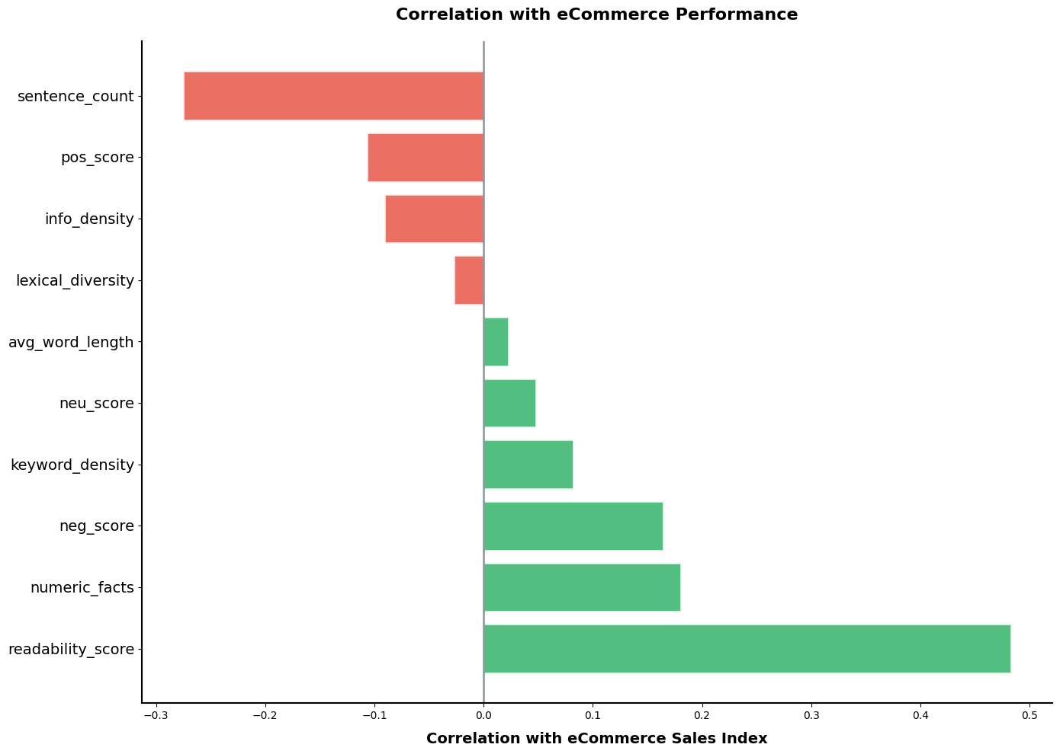
Understanding Correlation Patterns in the Sales Index
Notes:
Negative score - Stuff like no artificial flavors, or preservatives etc.

Slide 5
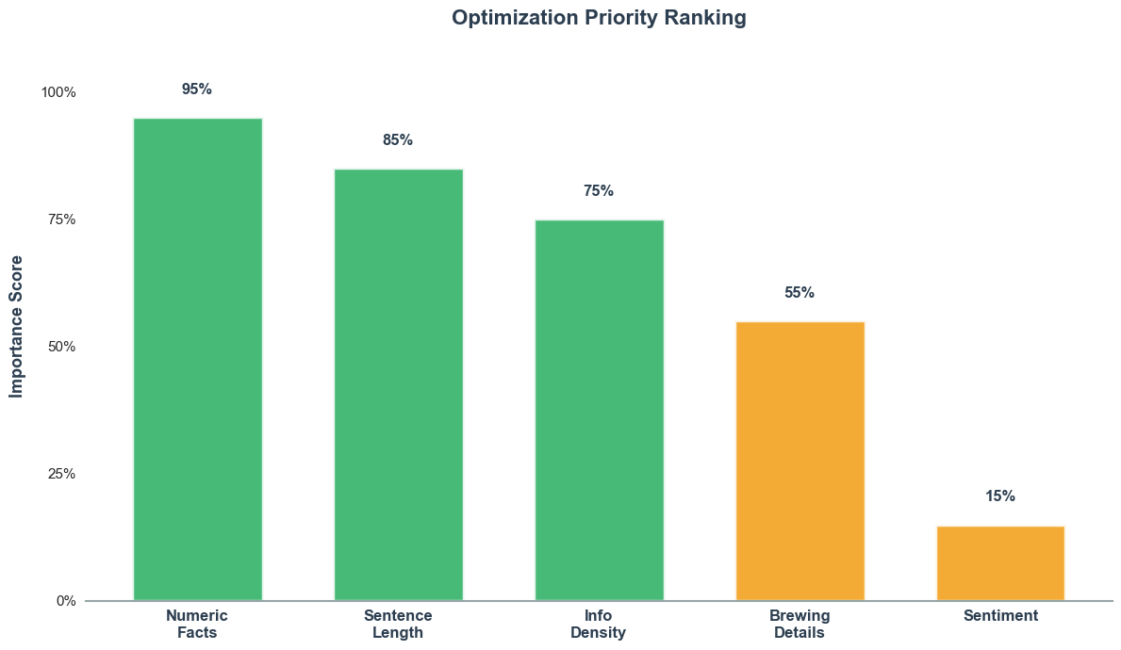
Facts, Length, and Density are the Top Drivers of AI Search Results
Notes:
get rid of title and bar on side

Slide 6
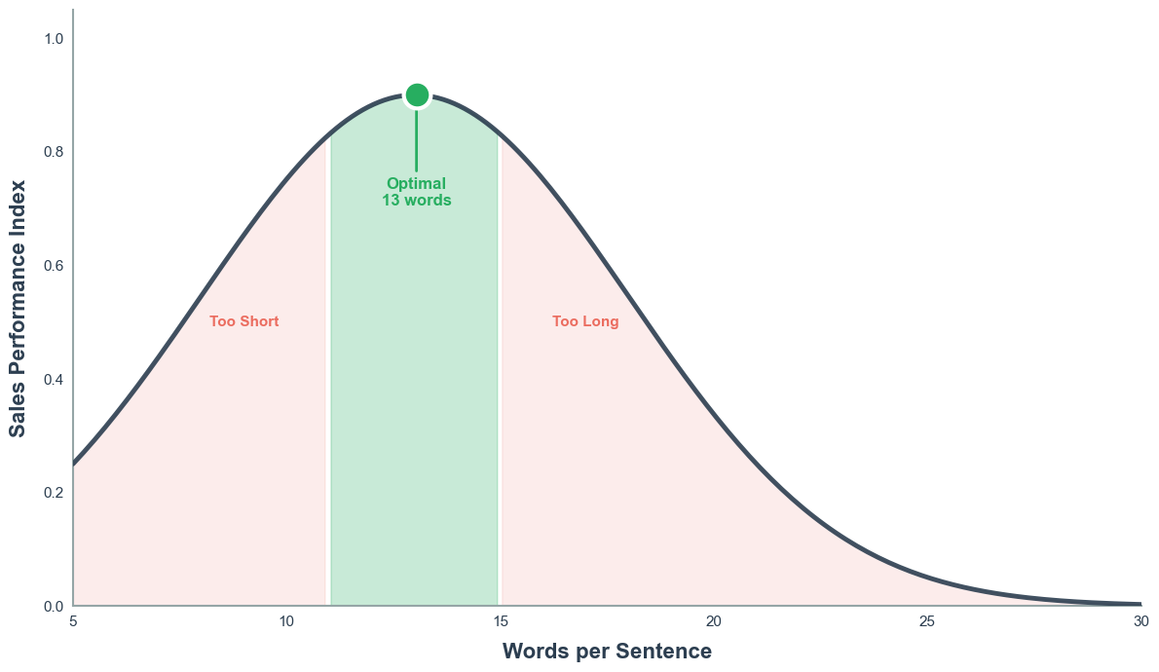
Optimal Sentence Length Should Be 11-15 Words
Notes:
get rid of title and legend

Slide 7
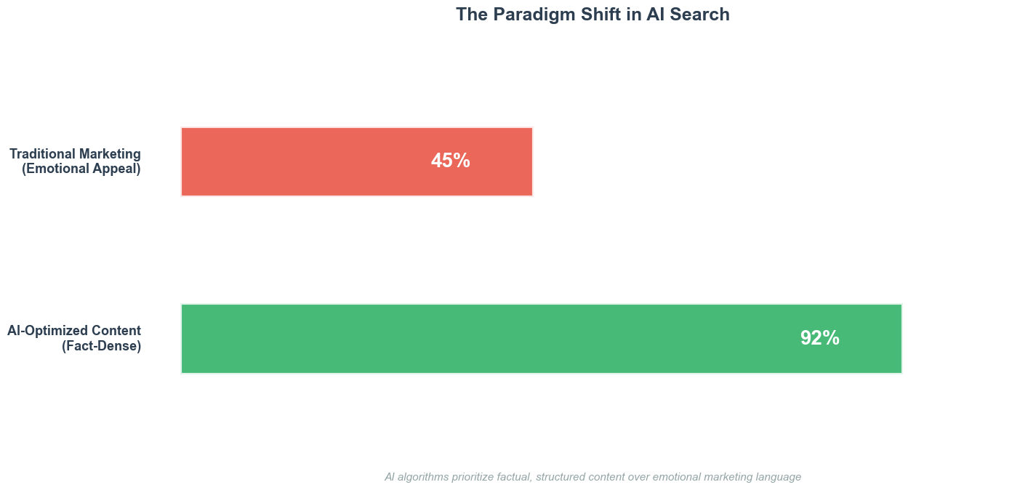
Fact Dense Ad Copy is Preferred By AI Search Engines
ChatGPT | Claude | Perplexity | Gemini
Notes:
"ugly" too much white space

Slide 8
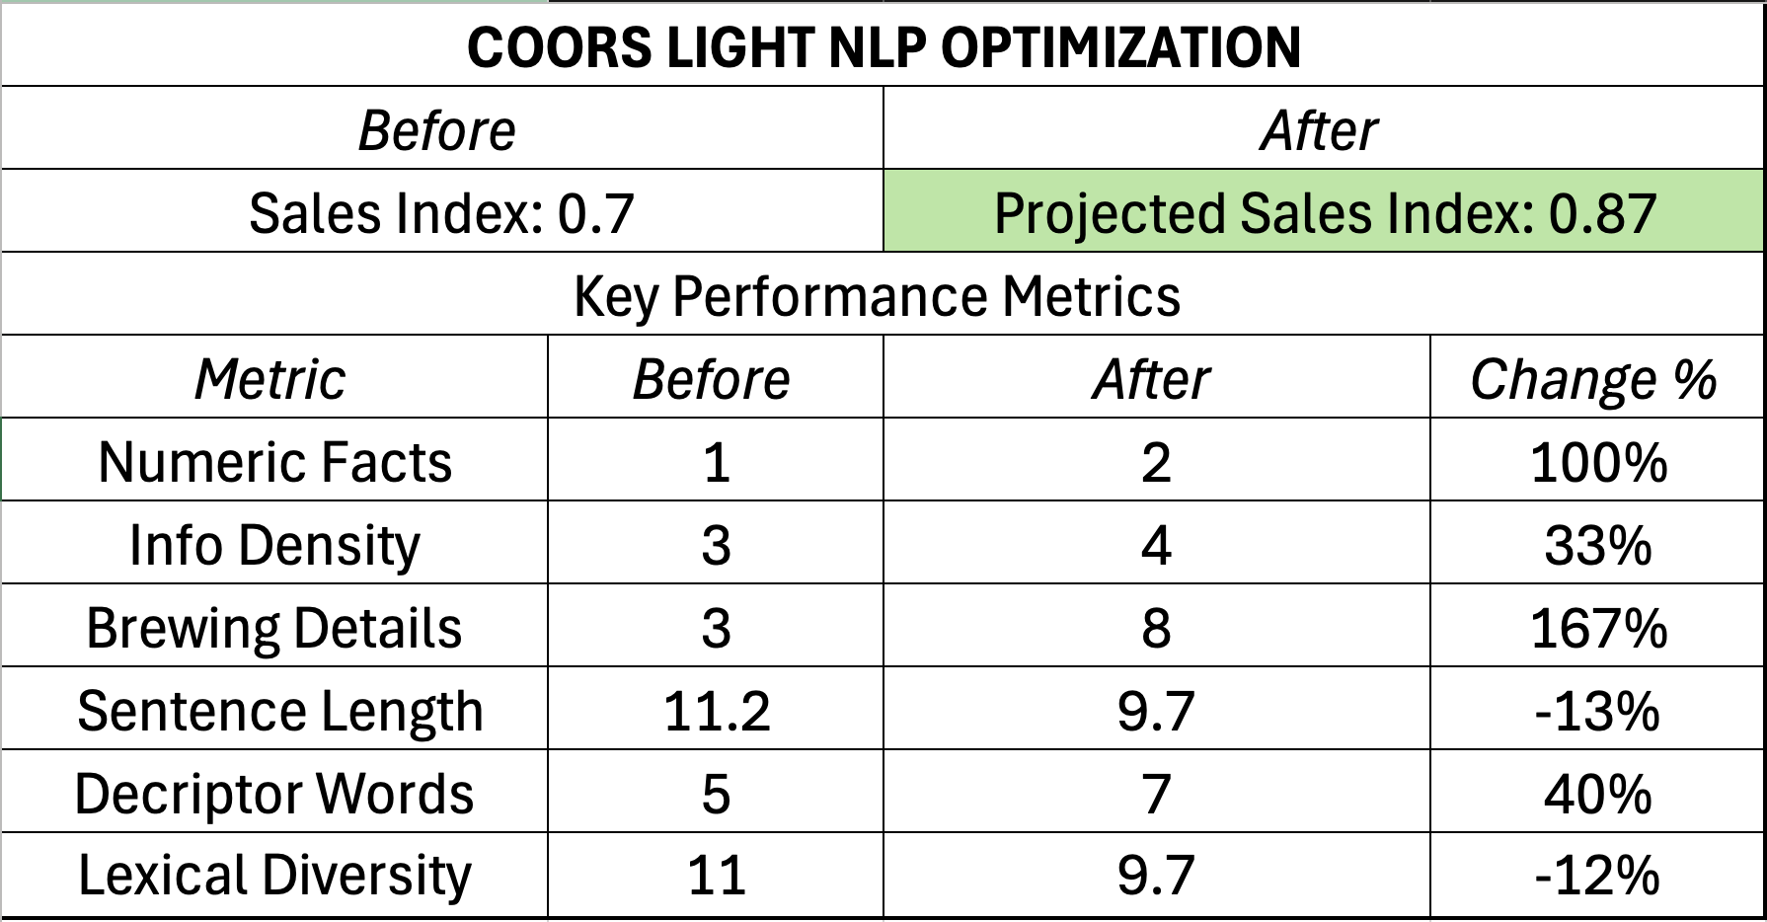
Optimizing Product Description
AI search Engines Increases Projected Sales Index Value by 24.3%

Slide 9
8-Week Actionable Implementation
Audit All Products
(Weeks 1-2)
Test and Monitor Performance
(Weeks 5-6)
Data Collection and Engagement
(Weeks 3-4)
Redefine and Scale
(Weeks 7-8)

Slide 10
Regional Opportunities for Molson Coors
Kroger Priority States: Texas, Missouri, Ohio, Georgia, and North Carolina gaps ranging from 11.0 to 32.5 points
Key Take Away:
If Molson Coors closed the gap by just 10 points in these 5 states, it will increase their exposure to consumer search
Notes:
https://marketkeep.com/seo-keywords-for-breweries/

Slide 11




Long-Term Holistic Approach
Roll out optimized copy across all Molson Coors eCommerce channels
Establish ongoing monitoring dashboard
Track most popular beer related queries via Google Ads
Train marketing team on AI optimization best practices

Slide 12
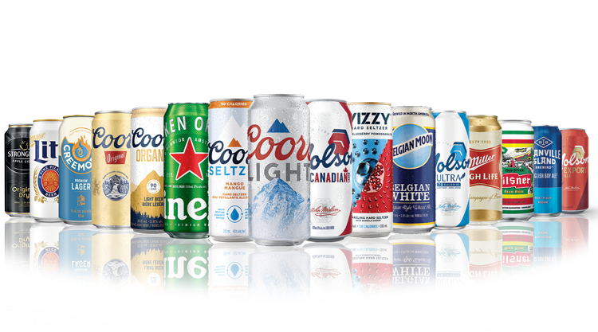
THANK YOU

